Slide 1

Emotion Detection for Reddit
Team – Web Wizards
Yash Jivani
Umair Abdul Raheem
Sagar Kale
Harshal Nanavare

Slide 2
High-level overview
1
2
3
4
5
Scraping and Cleaning
Labelled Datasets
Brainstorming
applicability of model
Make predictions by comparing both data sets
Testing accuracy of our model

Slide 3
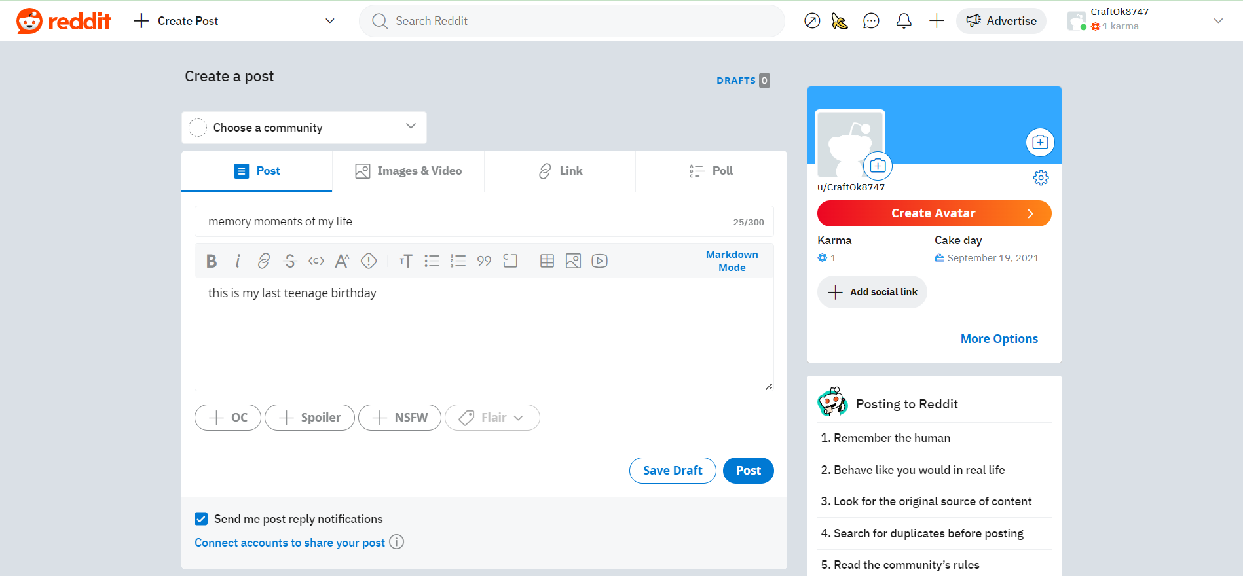
Introduction
How will it benefit Reddit?
What is our motive?

Slide 4
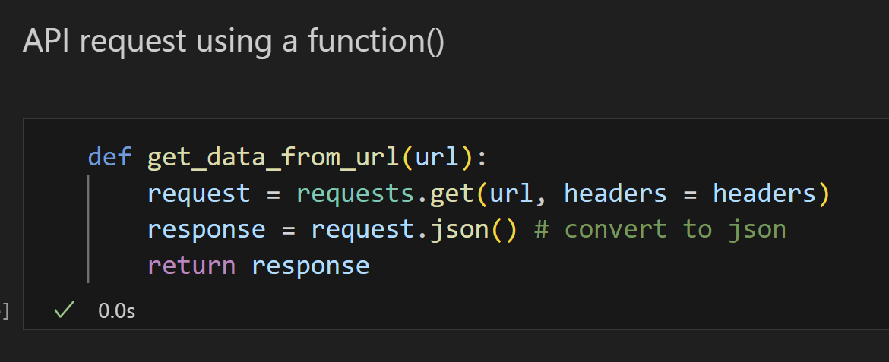
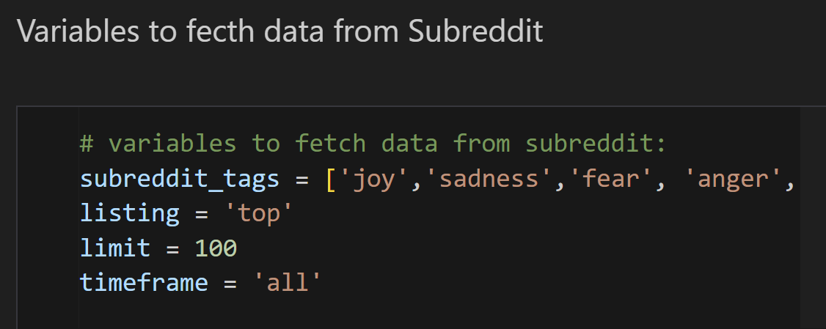
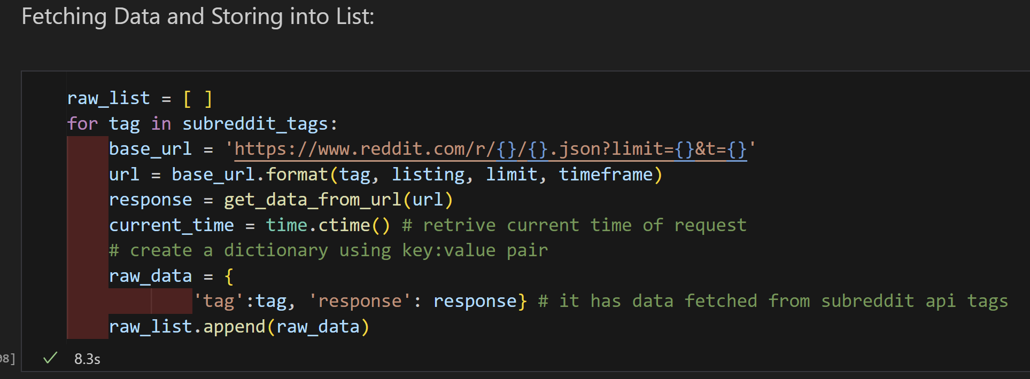
Data Scraping

Slide 5
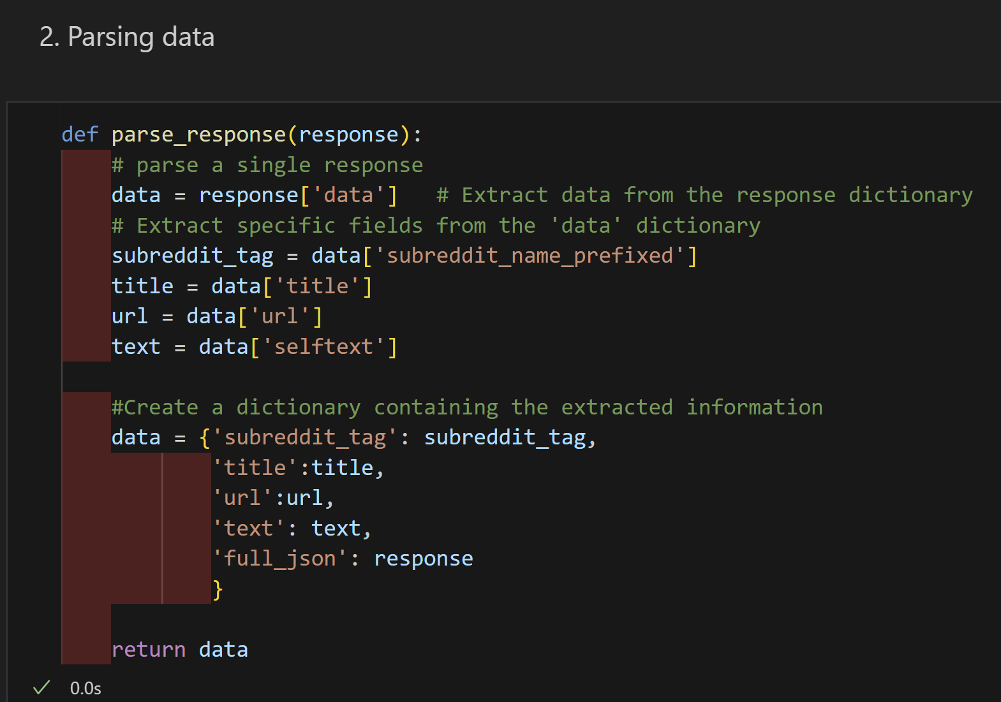
Data Parsing

Slide 6
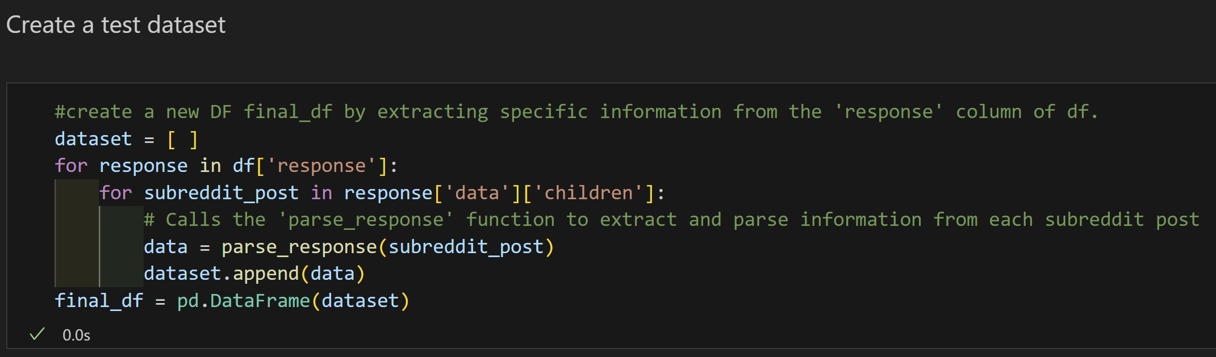
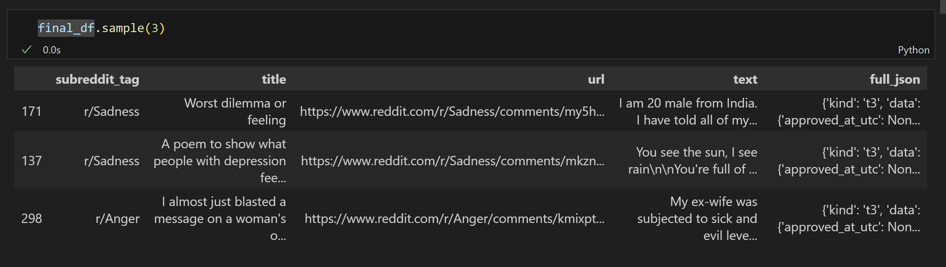

Slide 7
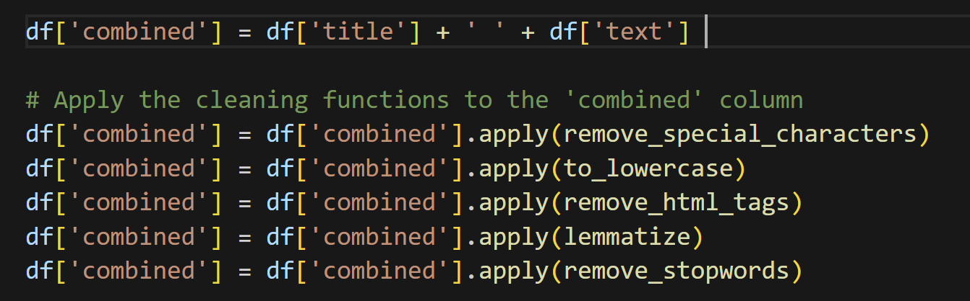
Data Cleaning

Slide 8
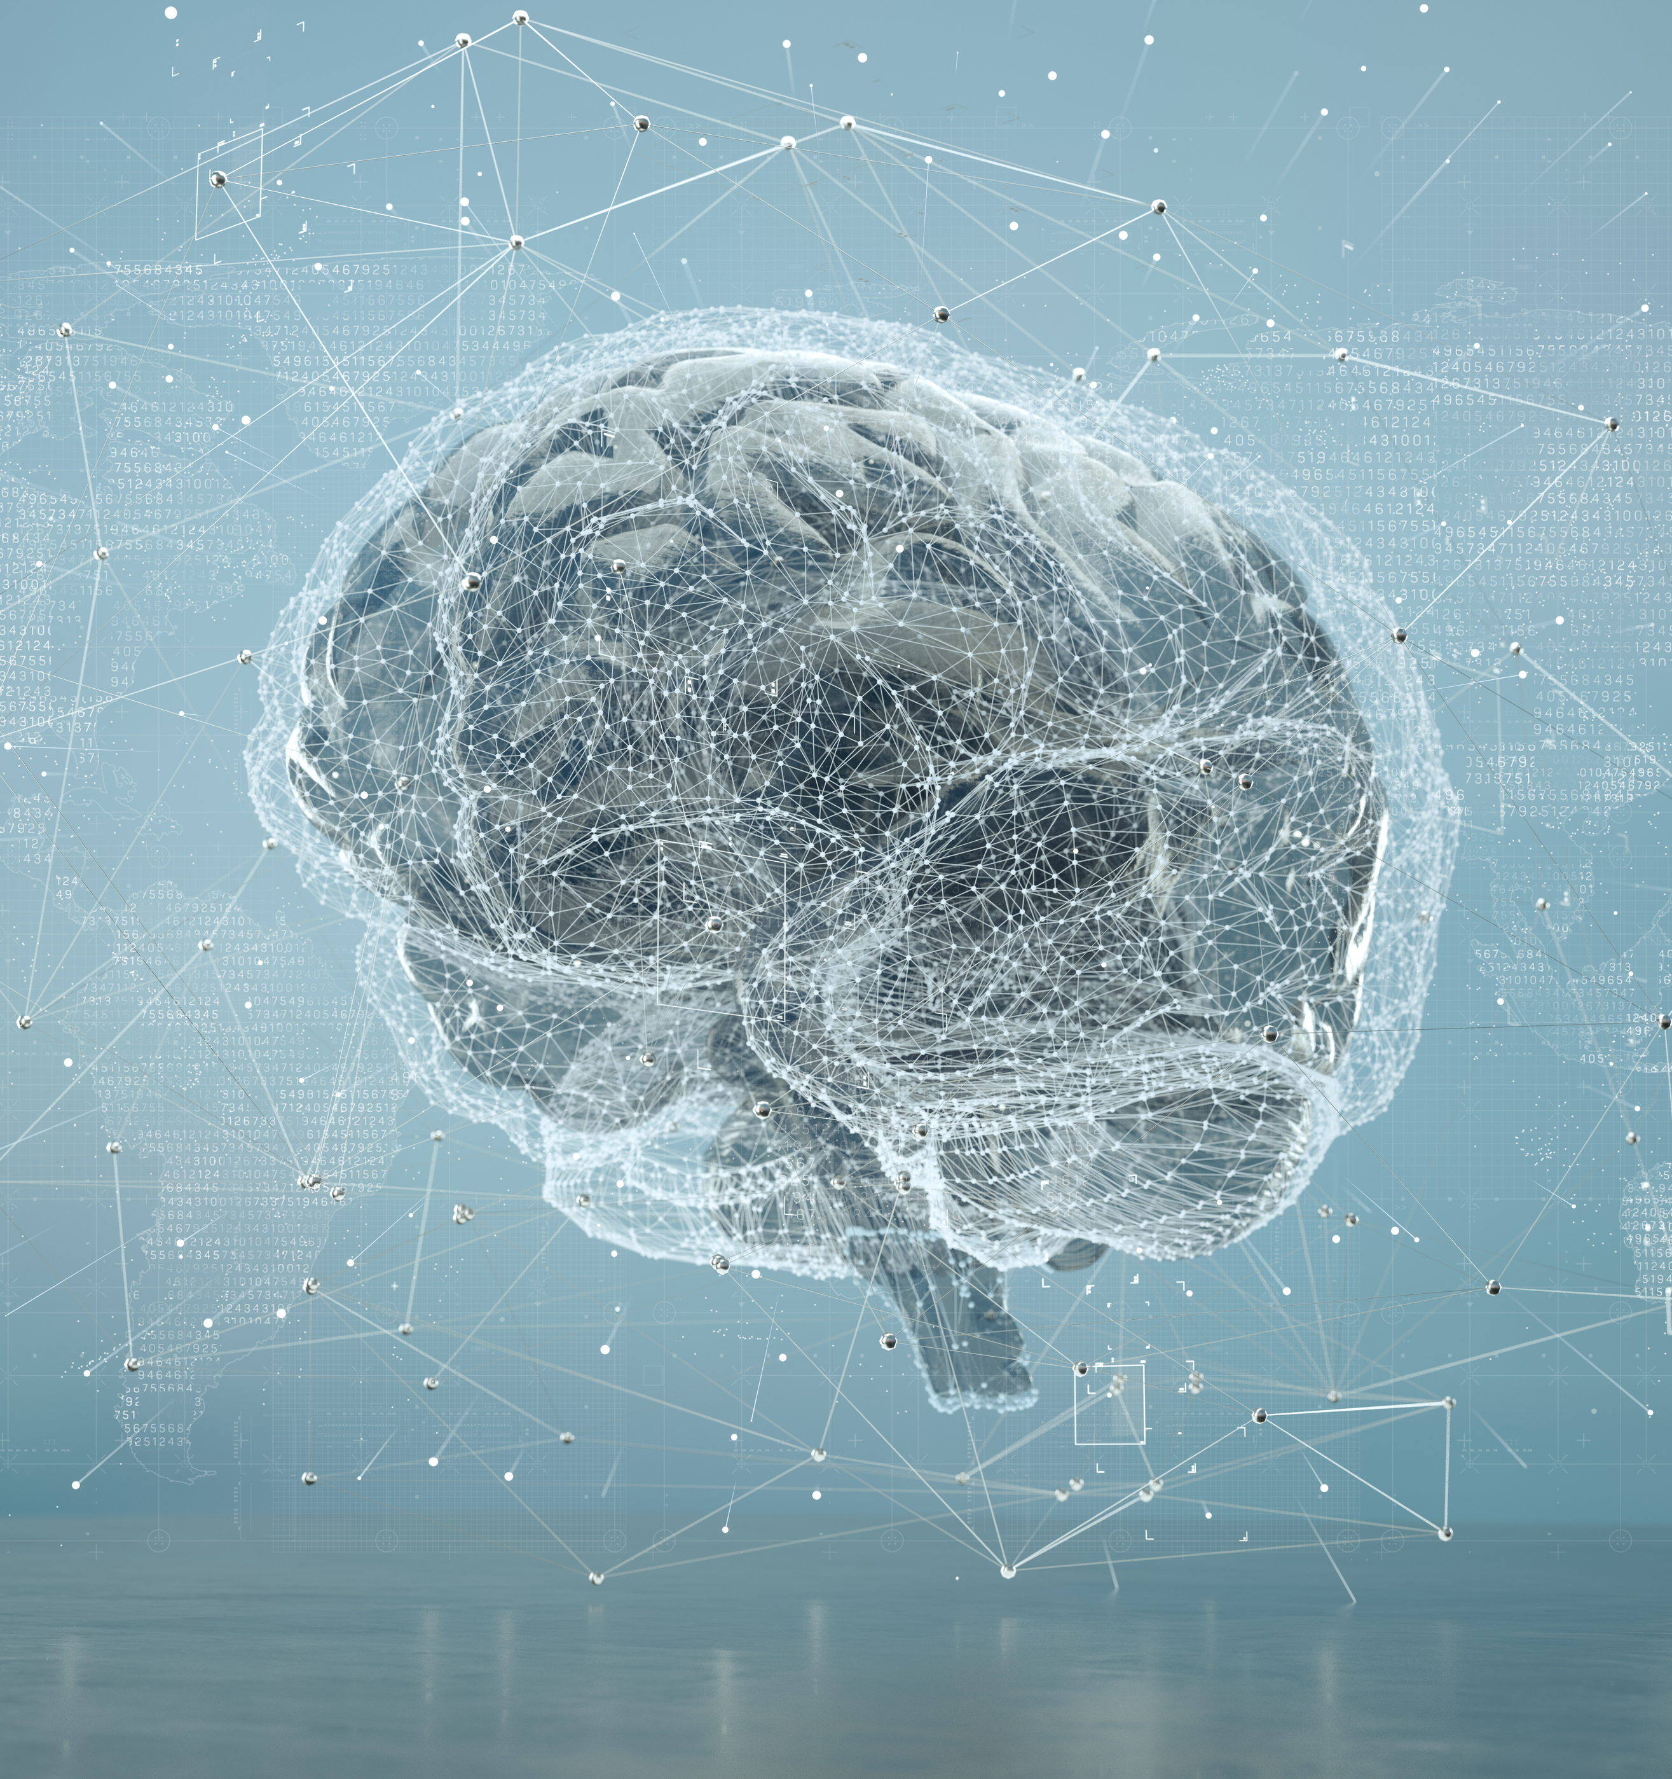
Training Data

Slide 9
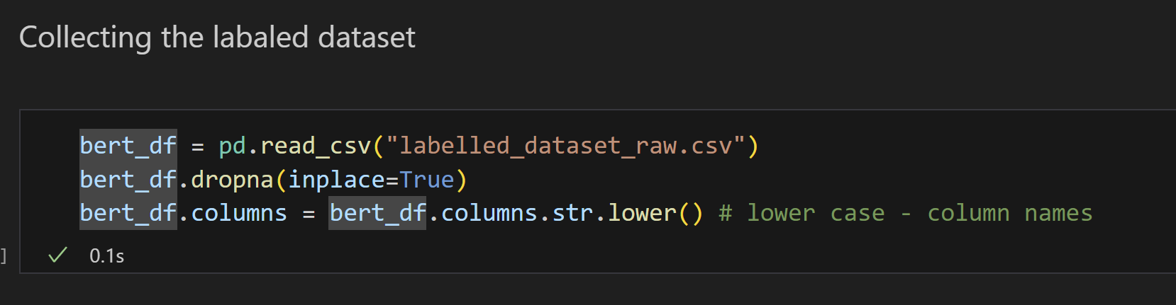
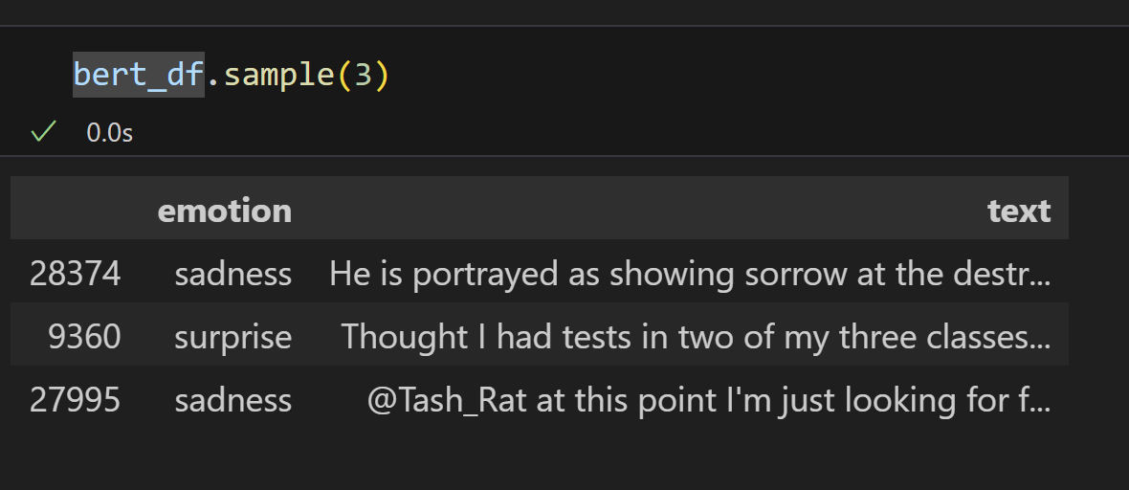
Loading Data

Slide 10
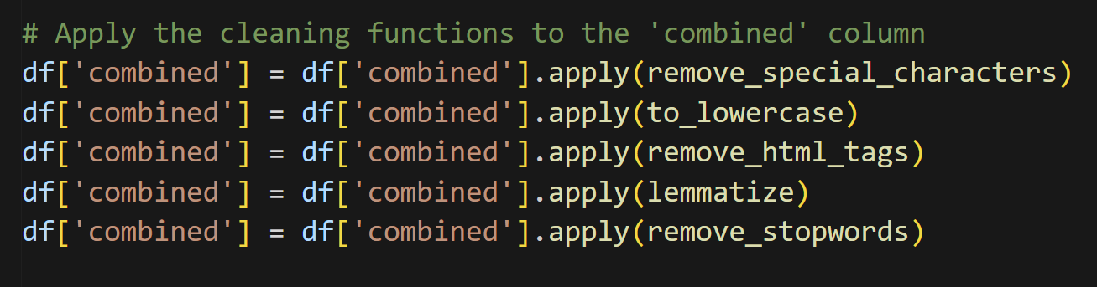
Data Cleaning

Slide 11
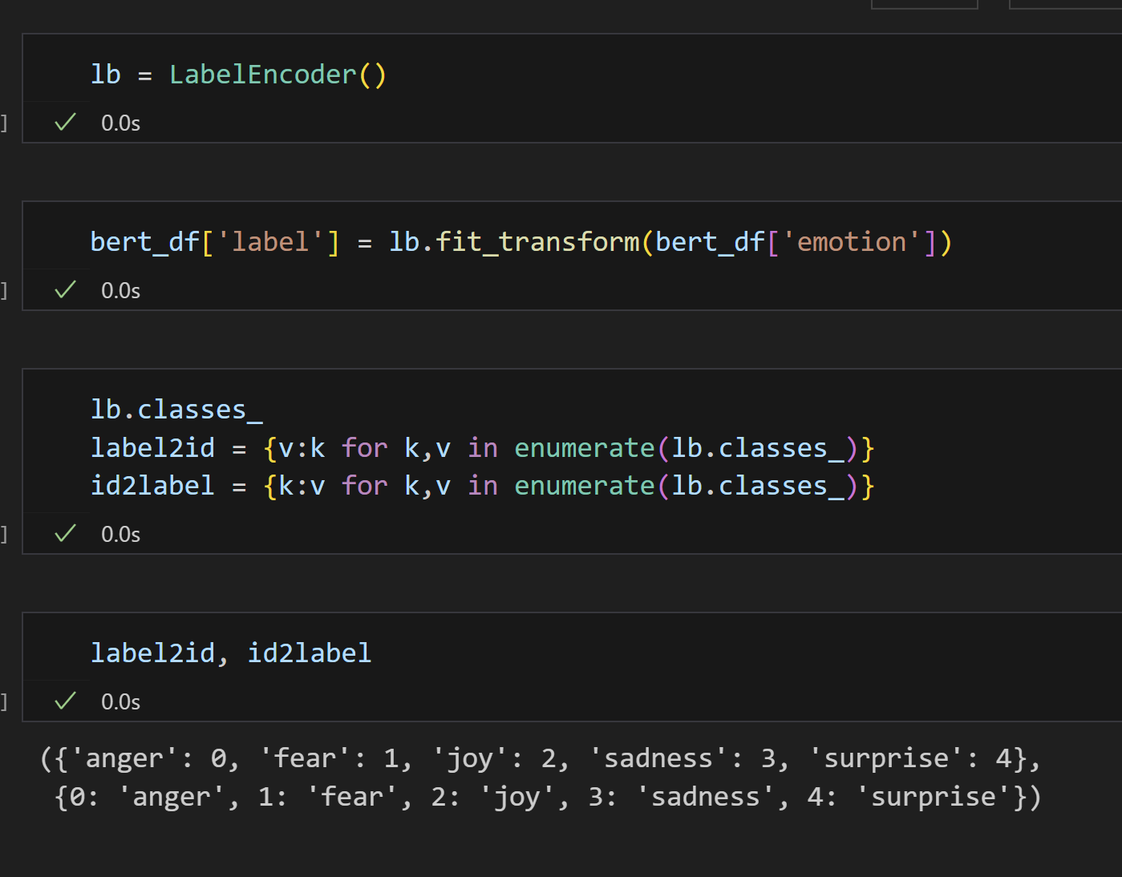
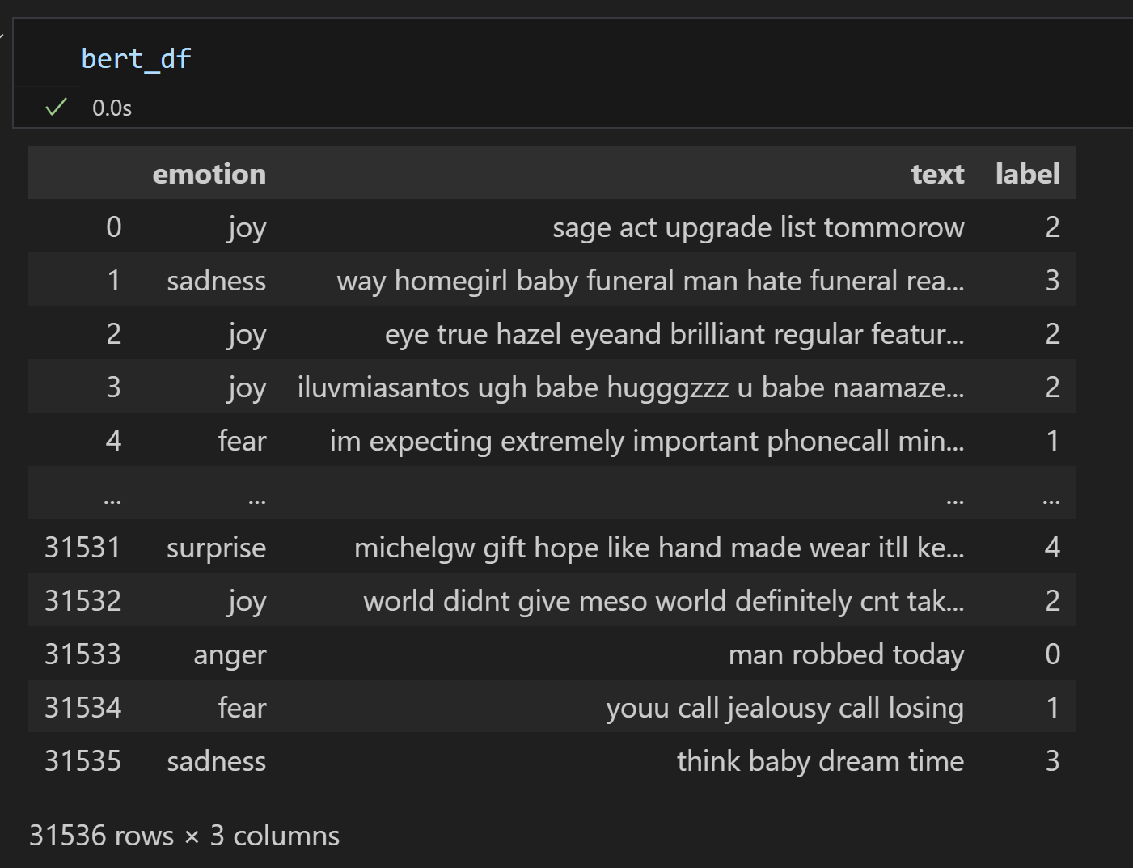
Encoding Labels

Slide 12
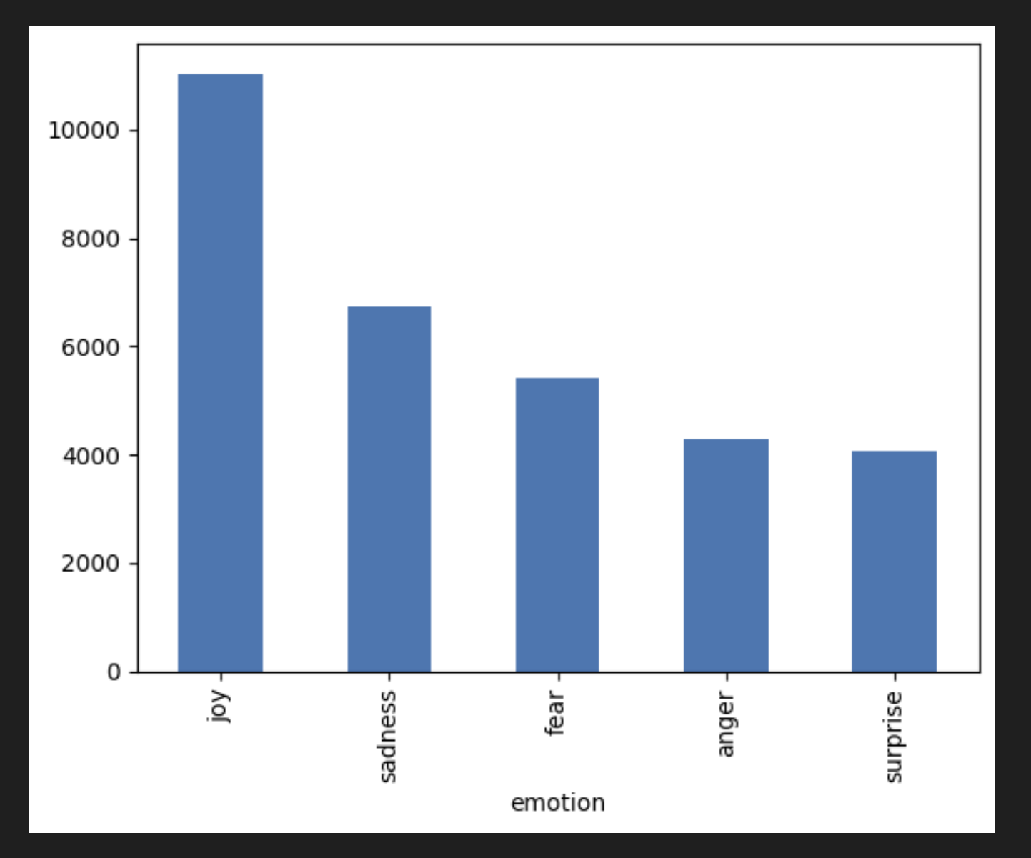
Distribution

Slide 13
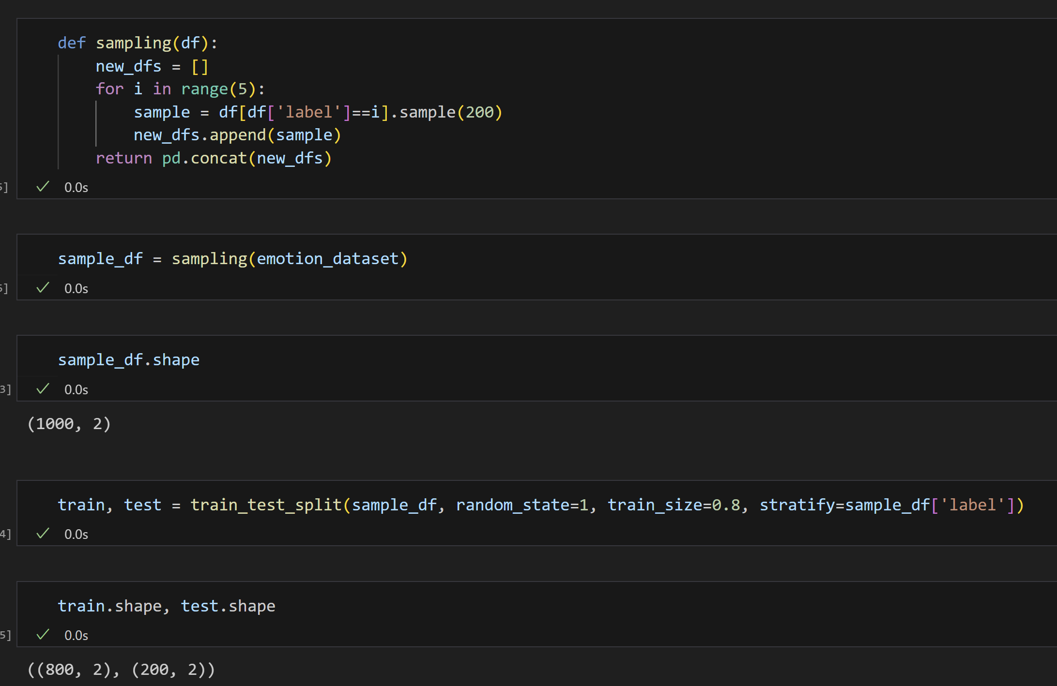

Slide 14

Model

Slide 15
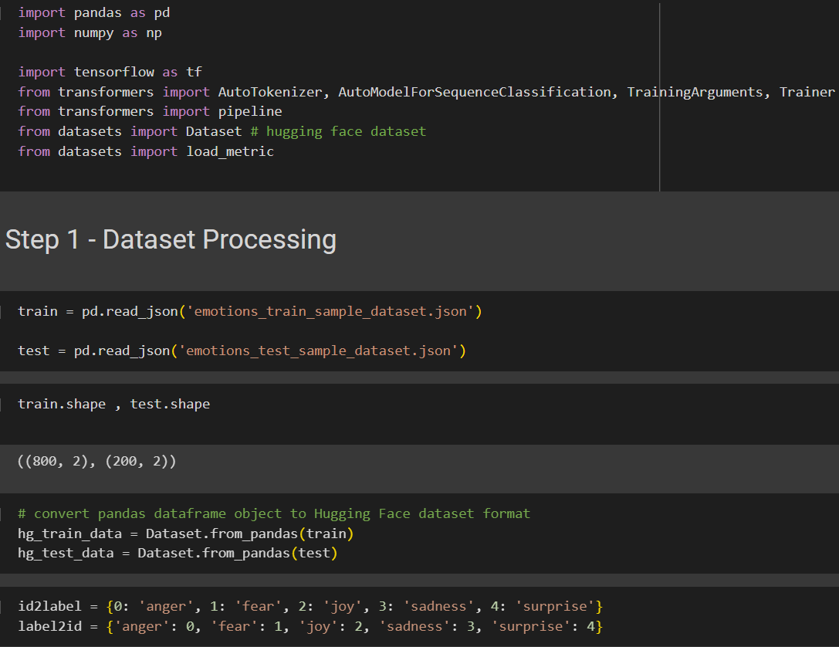
Model Training

Slide 16
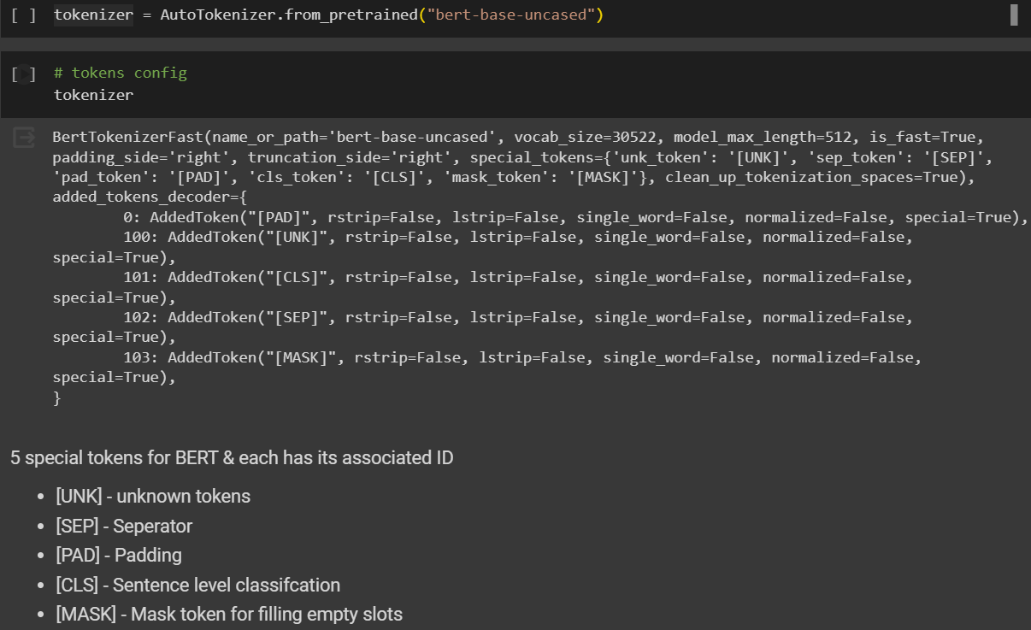
Model Training

Slide 17
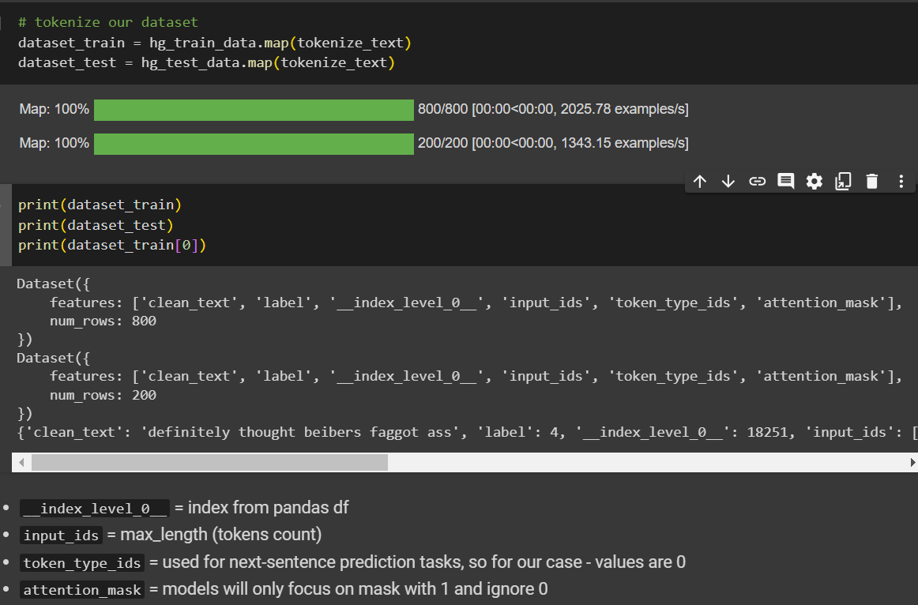
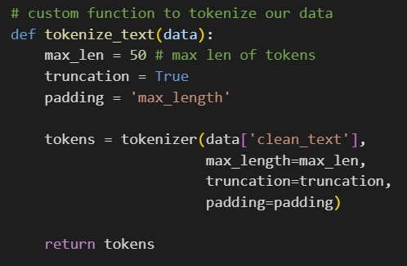
Model Training

Slide 18
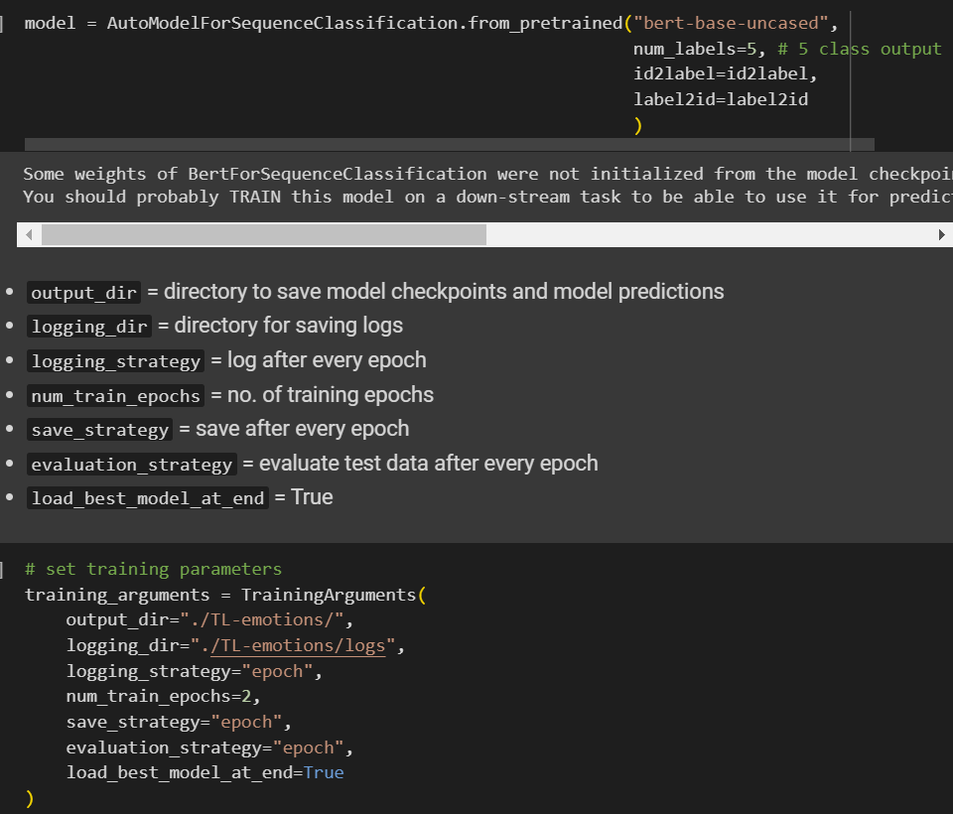
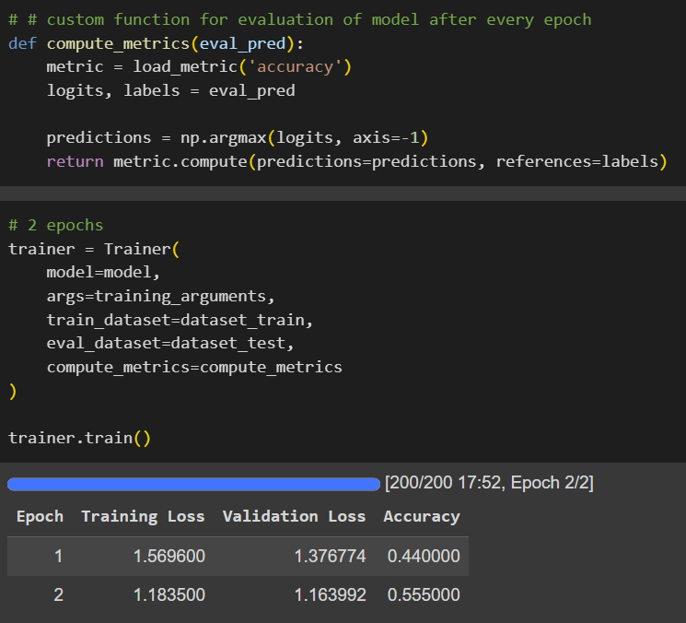
Model Training
AutoModelForSequenceClassification loads BERT model without sequence classification head (no specific output defined), so we have to defined the layer

Slide 19
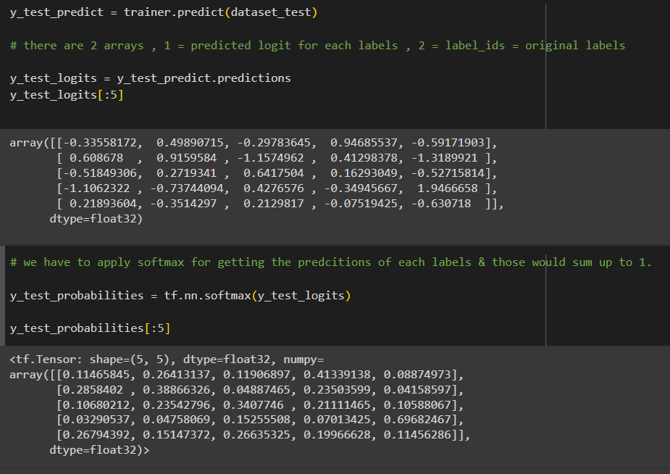
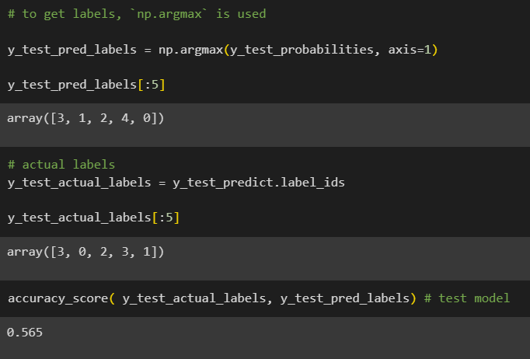
Model Predictions
Output from Network are logits
Convert to probabilities using softmax

Slide 20
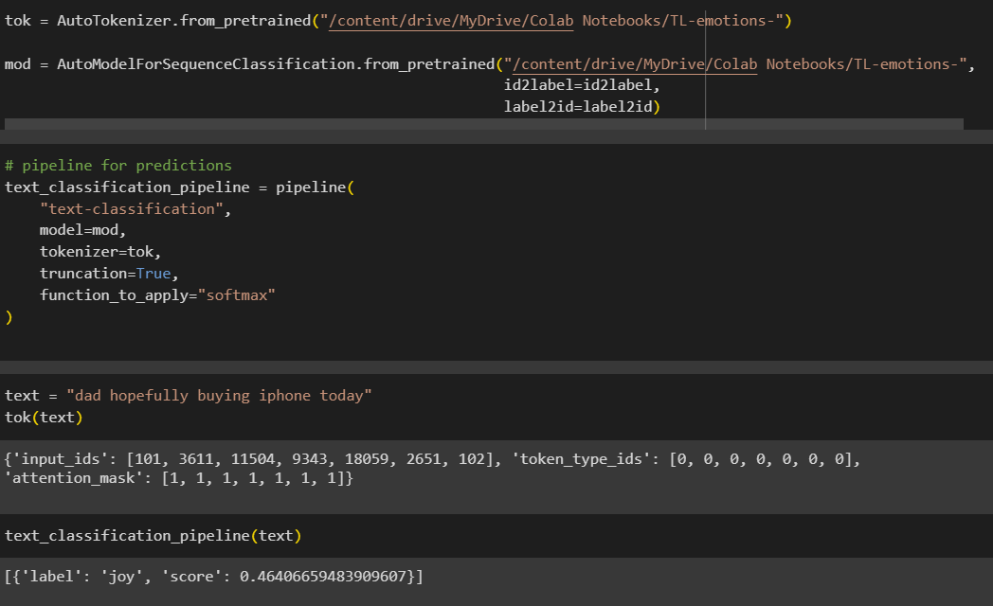
Testing Pipeline

Slide 21
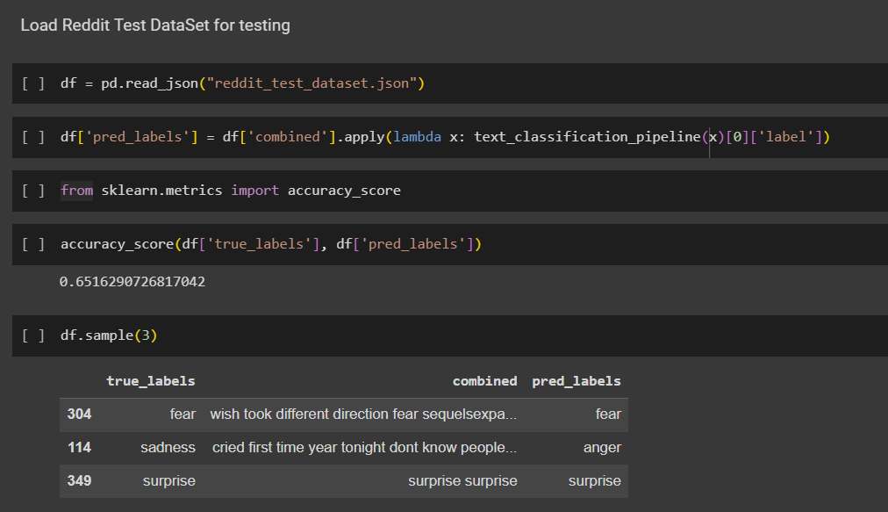
Testing Reddit Dataset

Slide 22
Future Scope

Slide 23
Future Scope
Replace Emoji (Unicode character) with real emotions/emoji-names
Replace emotion_characters :( & slang language words with actual English Words
Feed more dataset to fine-tune model and run more epochs and observe loss graph

Slide 24
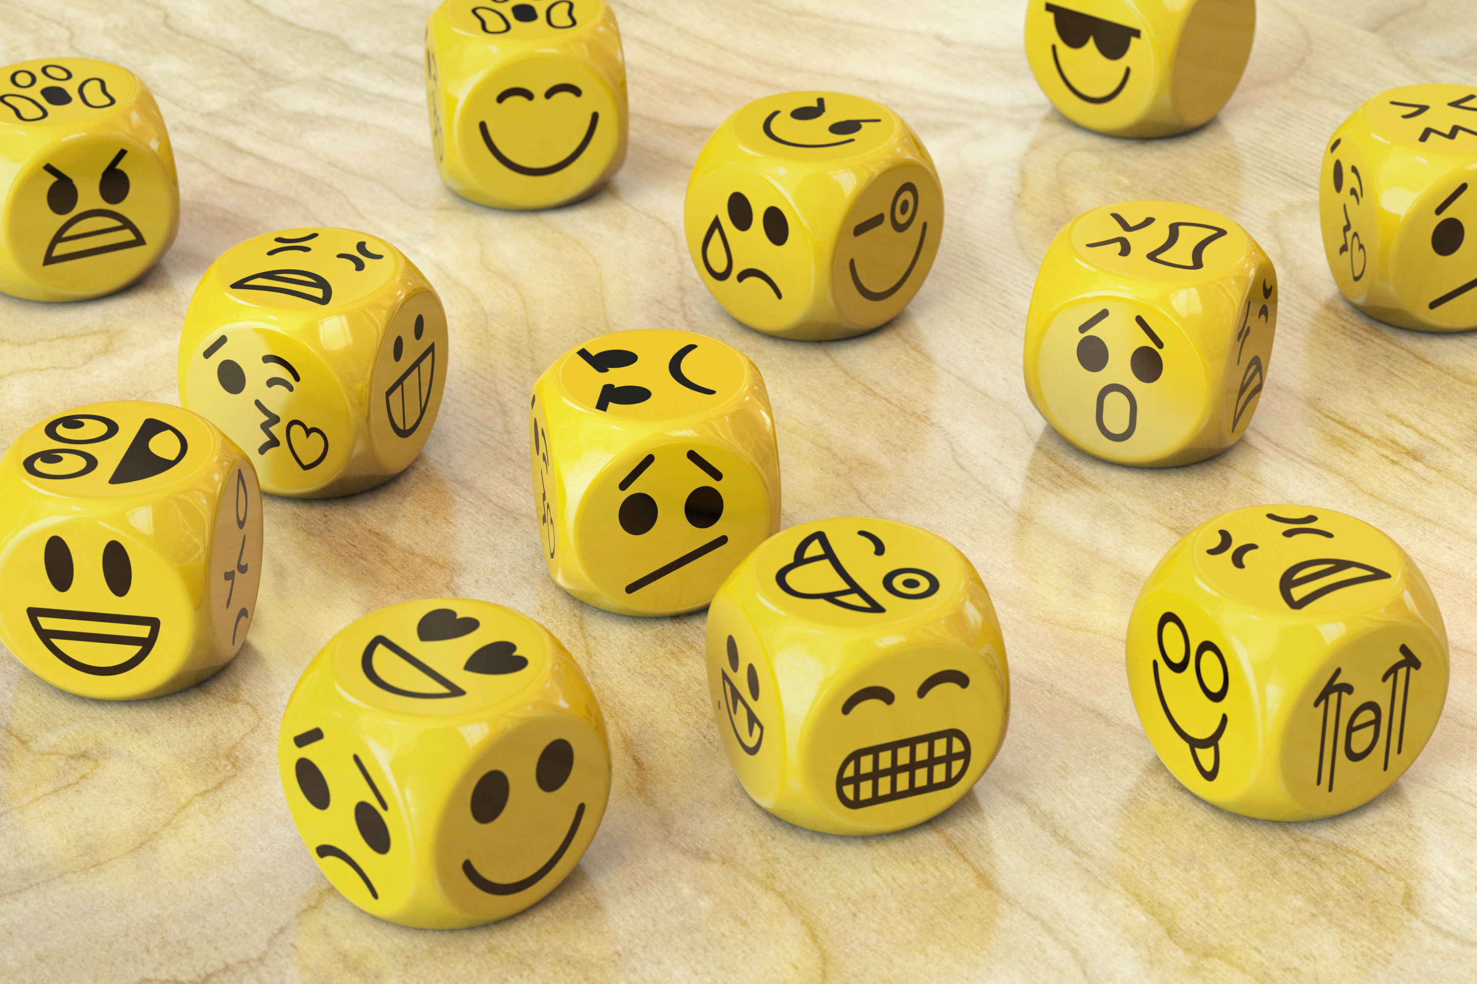
Thank you

